Slide 1
BT201
Biochemical Process Calculations
Energy Balance on closed and open system
20/10/2022

Slide 2
Energy balance for closed and open system
Based on Conservation of energy
Energy can neither be created nor be destroyed
Energy gained by a system must be exactly equal to the amount of energy lost by its surrounding
First law of thermodynamics
Only system that are homogeneous, not charged effects will be studied here

Slide 3
Points to be remember
Heat:
For adiabatic process (perfect insulation), Q=0
Work:
Movement of system boundary against a resisting force
Movement of piston, rotation of shaft
If there is no moving part, then W=0
Kinetic energy
If system is not accelerating , then KE=0
Potential energy
If the system is not falling or rising, then PE=0 w.r.t reference
Internal energy
Depends on the chemical composition, state of aggregation and temperature of the system
Independent of pressure for ideal gases and nearly independent of pressure for solids and liquids
If T and phase do not change, no reaction occurs and pressure change is less than a few atm, then ΔU=0

Slide 4
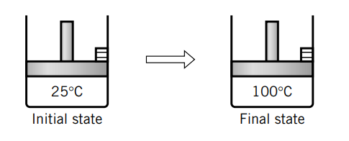
Energy balance on closed system
No mass flows in or out of the system
Energy balance equation
Rate of Accumulation of energy =rate of input of energy – rate of output of energy
Energy can transfer, so input and output terms exist
Energy transferred in the form of heat (Q) and work (W)
Accumulation : difference between the final and initial energies of the system
Q

Slide 5
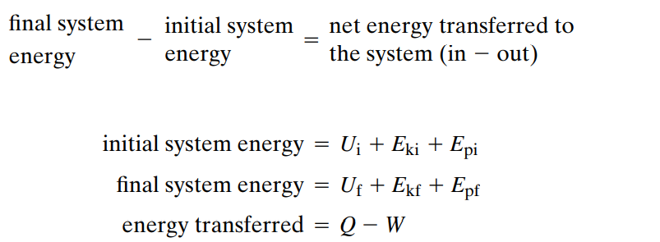

Convention use here:
Q is positive when supply to the system
W is positive when it is done by the system
First law of thermodynamics for a closed system
Each term represents net cumulative amount over a specific time interval, not energy per time

Slide 6
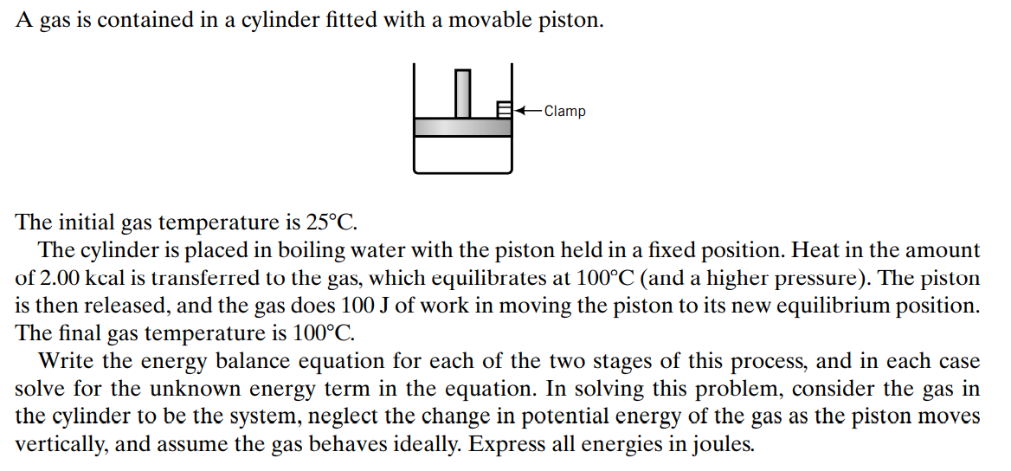
Example1

Slide 7
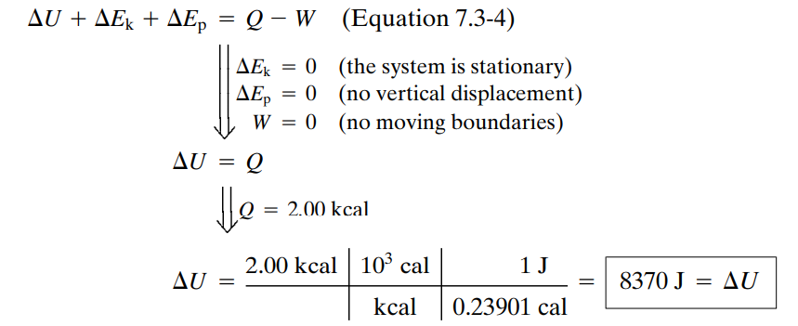
An additional 100 J of heat is transferred to the gas as it expands and re-equilibrates at 100 C.

Slide 8
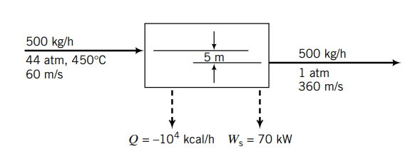
Energy balance on open system at steady state
Mass crossing its boundaries as the process occurs.
Work must be done on such a system to push mass in, and work is done on the surroundings by mass that emerges.
Mass entering: work done on the system
Mass leaving: work done by the system
Both work terms must be included in the energy balance.

Slide 9
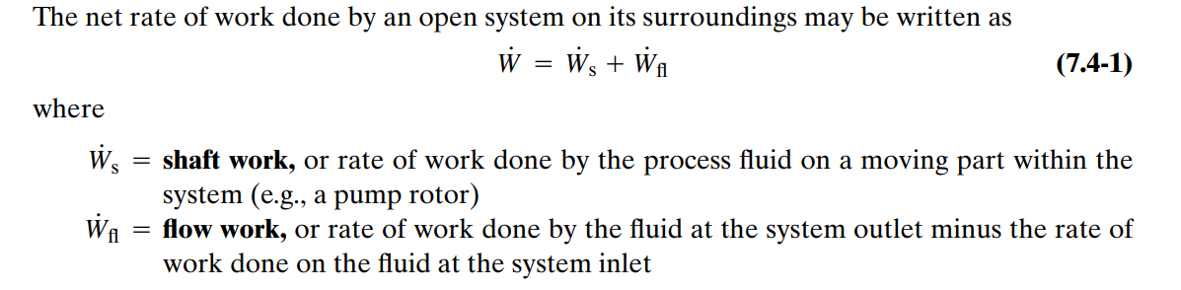
Net work done

Slide 10
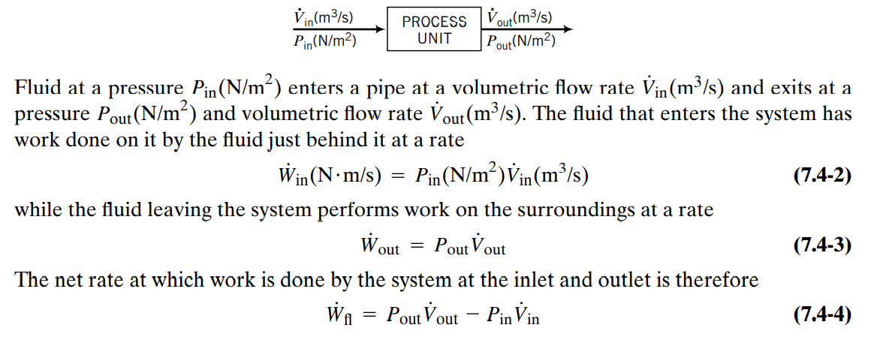
Flow work

Slide 11
Cont.
The first law of thermodynamics for an open system at steady state has the form
Rate of Accumulation of energy =rate of input of energy – rate of output of energy
At steady state,
input = output
“Input” here signifies the total rate of transport of kinetic energy, potential energy, and internal energy by all process input streams plus the rate at which energy is transferred in as heat
“output” is the total rate of energy transport by the output streams plus the rate at which energy is transferred out as work
Q
W

Slide 12
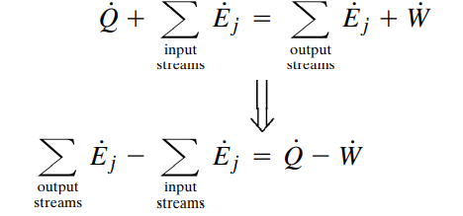

Cont.
Q
W

Slide 13
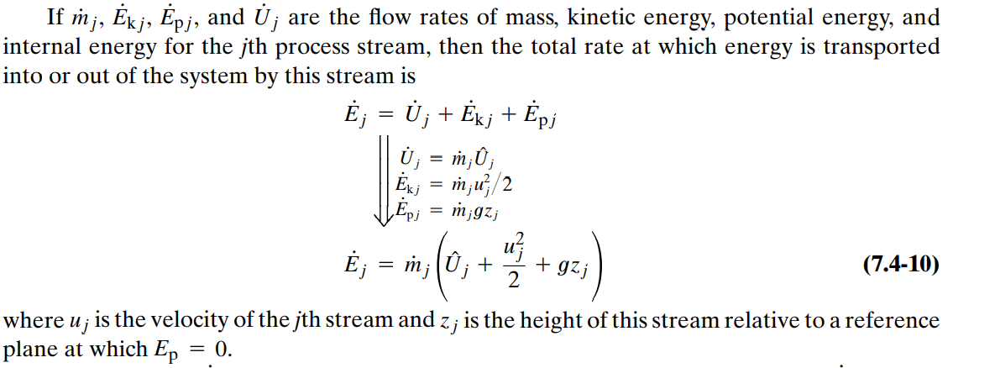

Cont.
Q
W

Slide 14
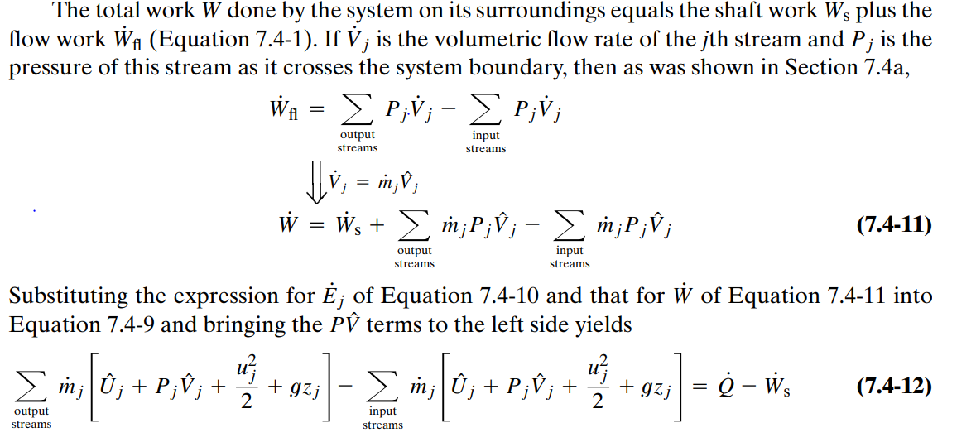


Cont.
Q
W

Slide 15
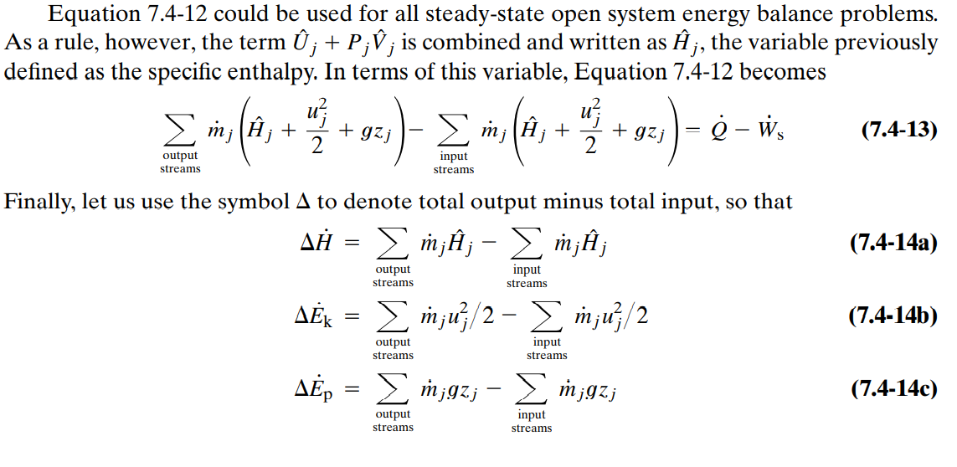
Cont.

Slide 16

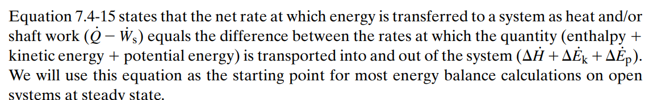
Cont.

Slide 17
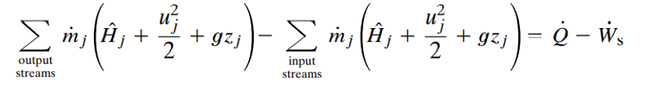
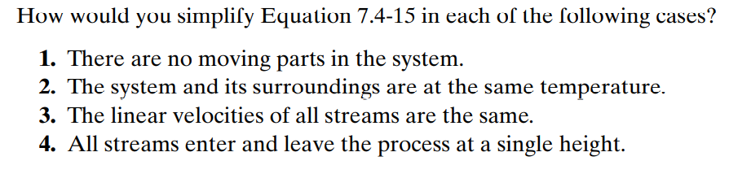
Cont.

Slide 18
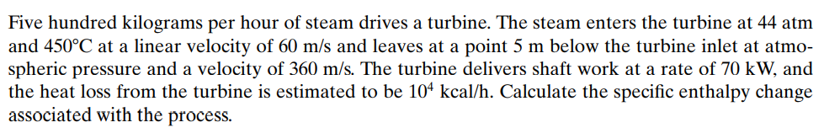

Slide 19
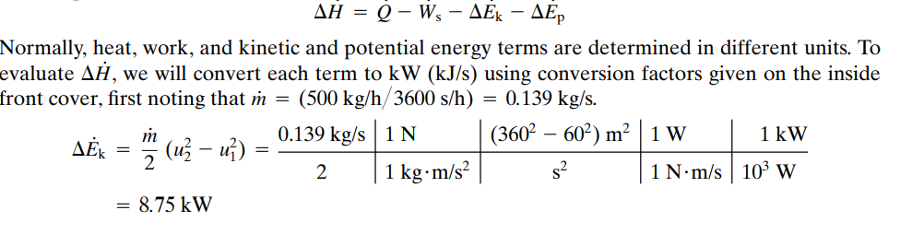

Slide 20
